Slide 1
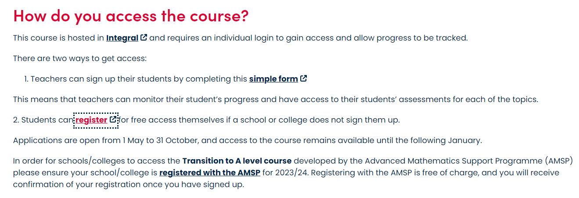

Slide 2
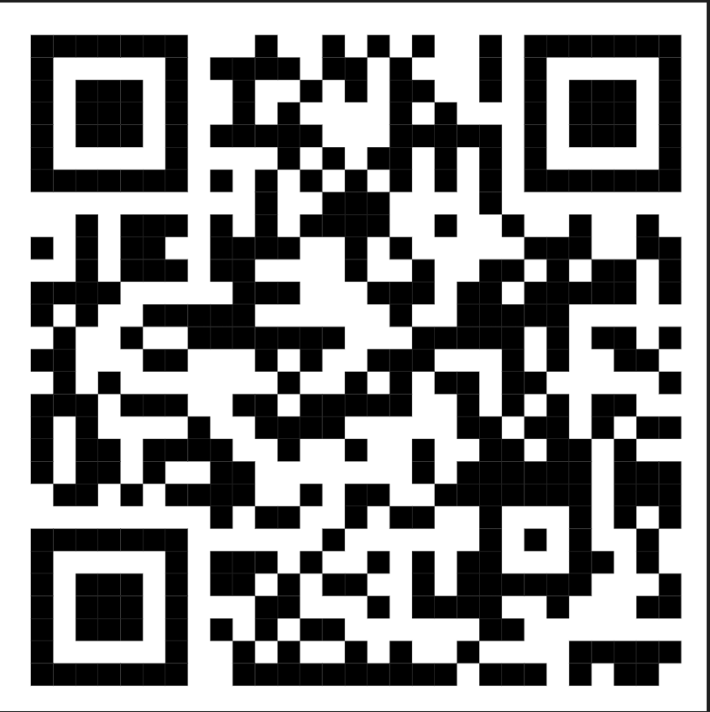

Slide 3
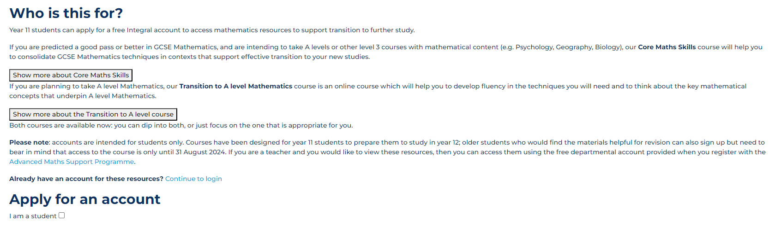
Transition to A level Mathematics course 2024 – AMSP

Slide 4
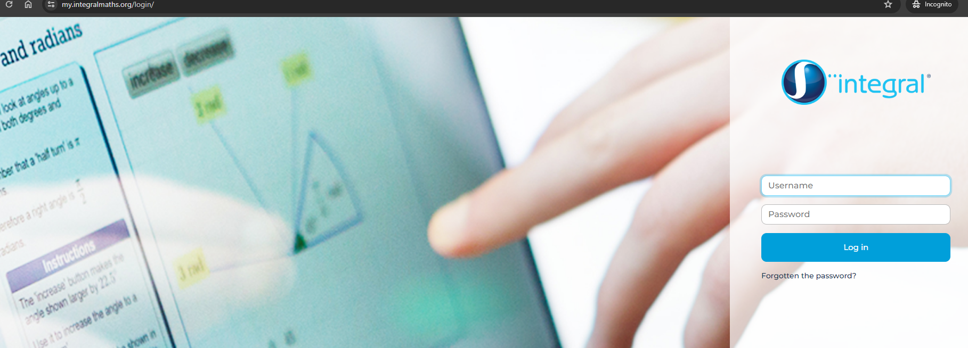
Once registered check your email for your Account username
Your password will arrive in a separate email.
After you have your second email – log in to get started.

Slide 5
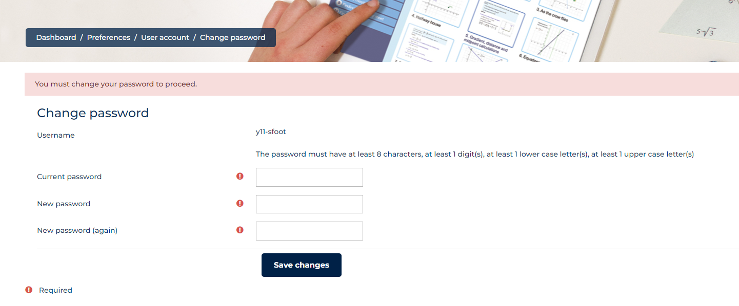
Change your password to continue

Slide 6
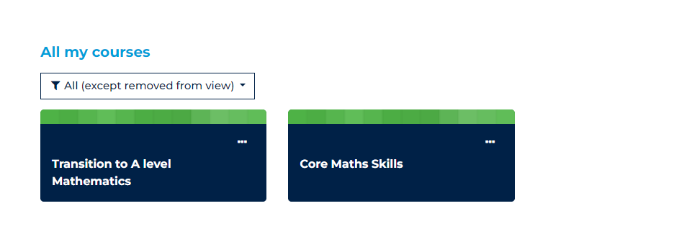
Pick the A level course

Slide 7
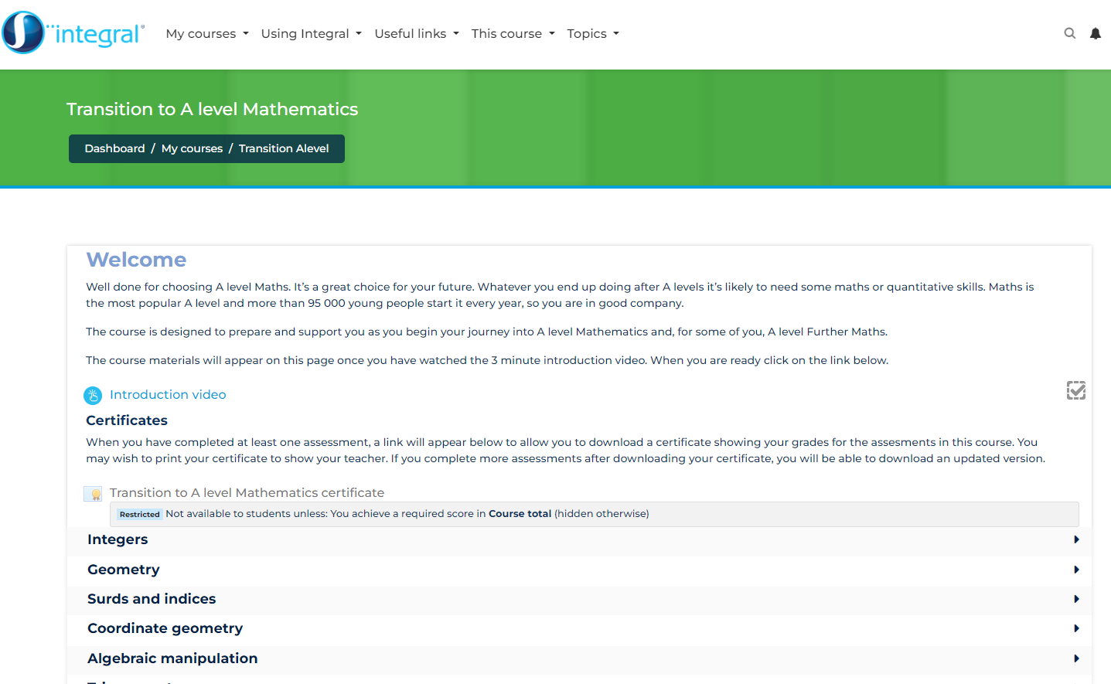
Homepage
Start with the video
Unless the tick is done you can’t unlock the next materials
https://my.integralmaths.org/mod/hvp/view.php?id=59768

